Slide 1
Towards circular water: Upscaling advanced wastewater treatment by ozonation for pharmaceutical control
J. Versteegh, T. van de Pol, M. Spruijt, M. Hoekstra

Slide 2
Research partners
HHNK, Water Authority North Holland
PWN, Water Supply Company North Holland
PWN Technologies, R&D Drinking Water Technology

Slide 3
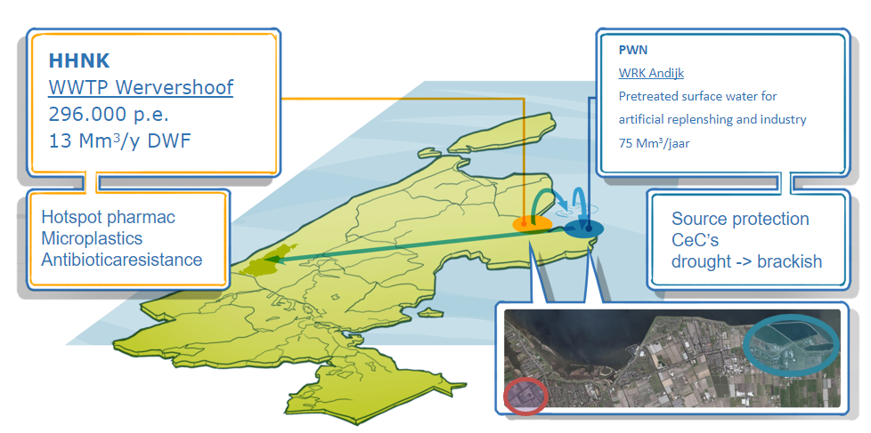
Stakeholders interests research
HHNK: Quality improvement
PWN: Source protection
HHNK & PWN: Wastewater reuse

Slide 4
Technical requirements
70% OMP degradation over the entire treatment process
Bromate formation must be manageable

Slide 5
Research objectives
Comparing two ozone injection systems to make better informed design decisions for the full-scale plant at WWTP Wervershoof
Better understanding of ozonation and hands-on experience

Slide 6
Comparing ozone injection systems
Roturi®
Bubble Column
Inline injection
Rotating venturi
No full-scale experience on WWTP effluent
Conventional system
Proven technology for WWTP effluent (Germany, Switzerland)

Slide 7
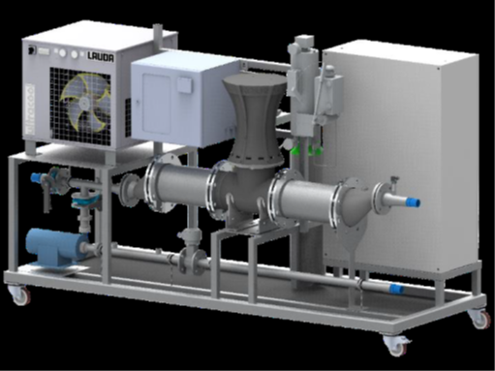
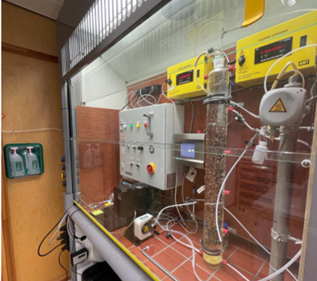
Experimental setup
Roturi® pilot (10 m3/h)
Bubble Column bench scale (6 L)

Slide 8
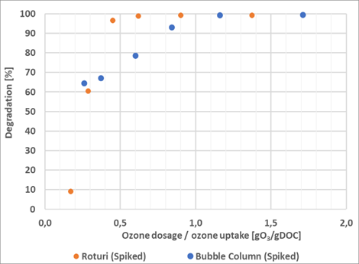
Roturi vs Bubble Column (Spiked)
11 Target pharmaceuticals
Detection limit
Spiked matrix (x100)

Slide 9
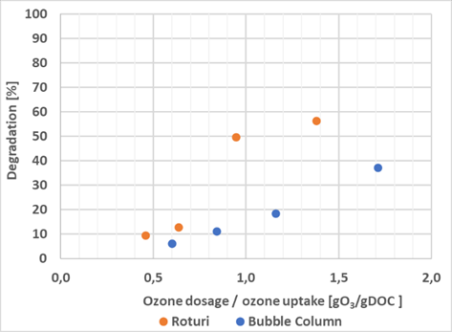
Roturi vs Bubble Column (Metformine)
Low reaction rate constant for ozone (K_{O3})
Requires higher ozone dosage

Slide 10
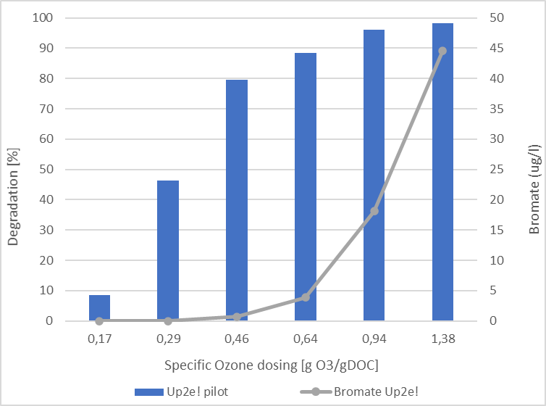
Bromate formation: Roturi
High bromate formation

Slide 11
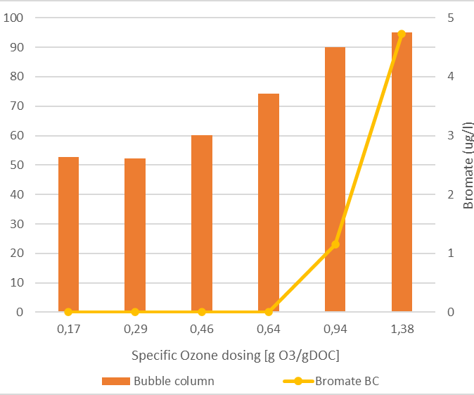
Bromate formation: bubble column
Relatively low bromate formation

Slide 12
Conclusions
The Roturi can degrade more OMP with a lower specific ozone dose than the bubble column
The Roturi forms bromate faster at a higher specific ozone dose

Slide 13
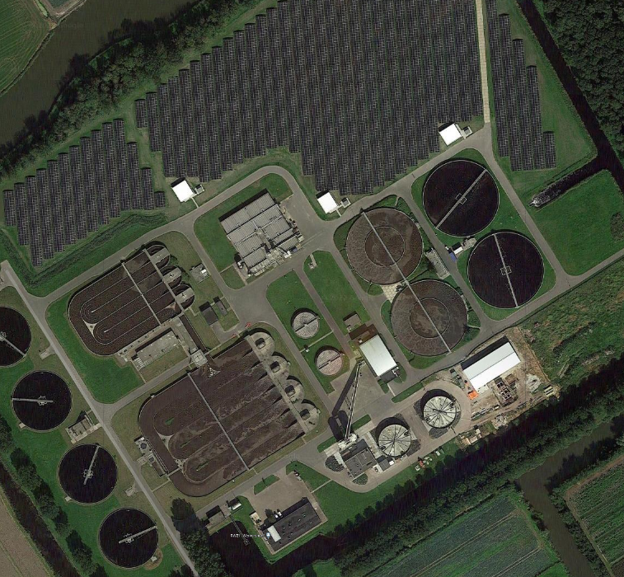
WWTP Wervershoof
Load: 296000 p.e.
Q24: 50000 m3/d
RWF: 7800 m3/h
DWF: 3000 m3/h

Slide 14
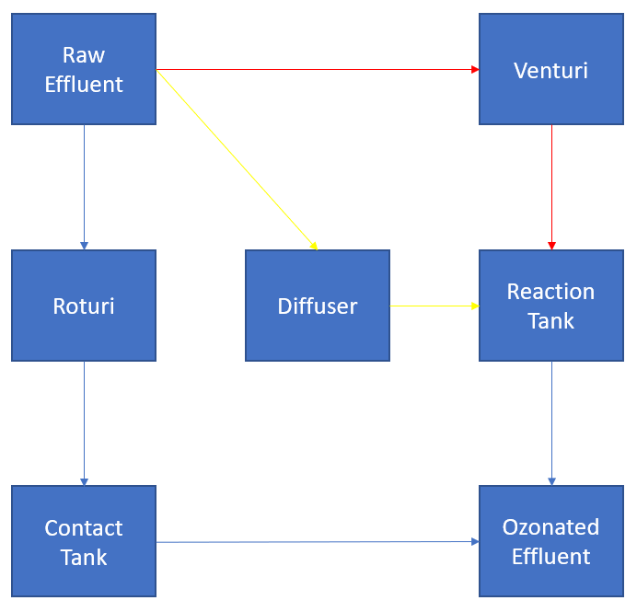
Design of the full-scale ozonation plant WWTP Wervershoof
3 different ozone injection systems
700 m3/h (1/4 of DWF)
Modular design
Expansion possible

Slide 15
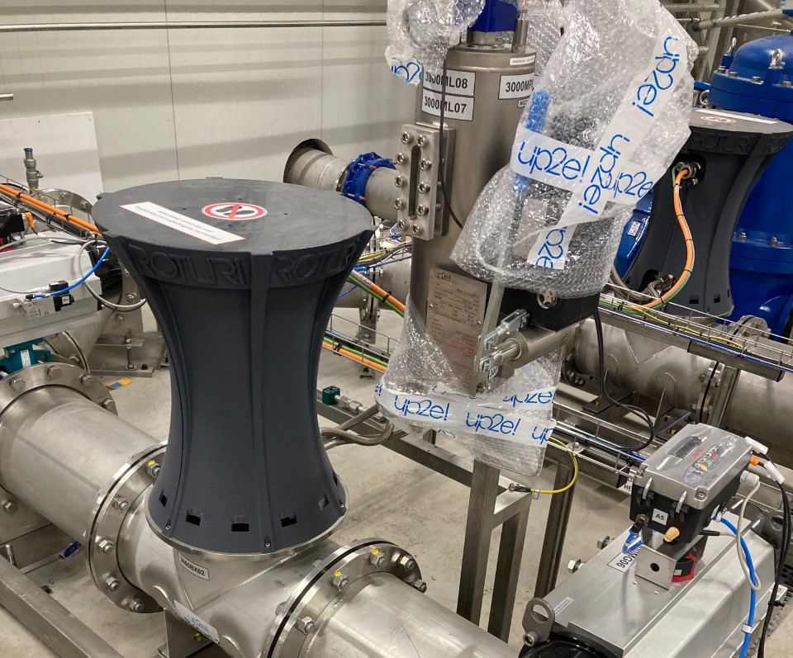
Roturi
Inline injection
Two Roturis
Compact
Contact tank

Slide 16
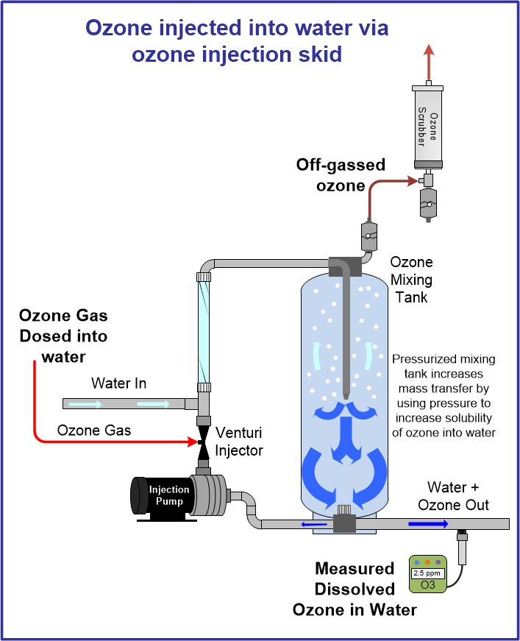
Venturi injection
Conventional
https://www.oxidationtech.com/ozone/solubility/venturi-injector-vs-bubble-diffusers.html

Slide 17
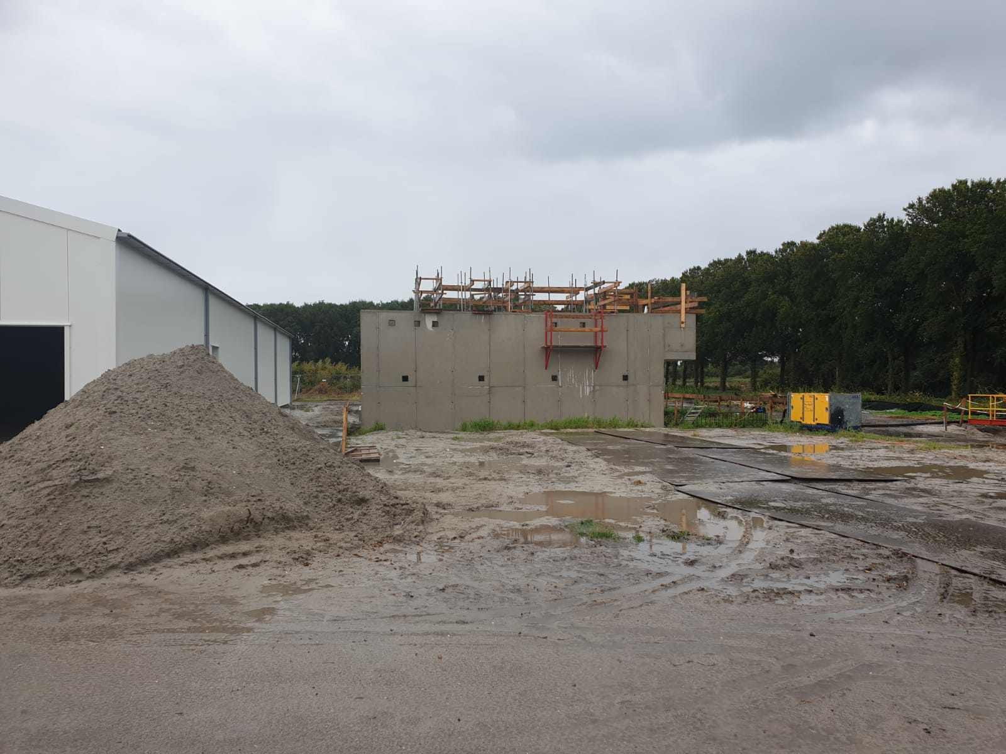



Diffusers
Ozone off-gas
Conventional
Reaction tank
Ozone

Slide 18
Scaling up!
Digital Twin for advanced process control
Poster presentation at YWP
Q3 - 2022

Slide 19
Acknowledgements
Ministery of Infrastructure and Water Management
IPMV (STOWA)
Topconsortia for Knowledge & Innovation (TKI)
Joop Kruithof

Slide 20




+31 6 82 62 01 46
j.versteegh@hhnk.nl
hhnk.nl
linkedin.com/in/jeremyversteegh

